Slide 1

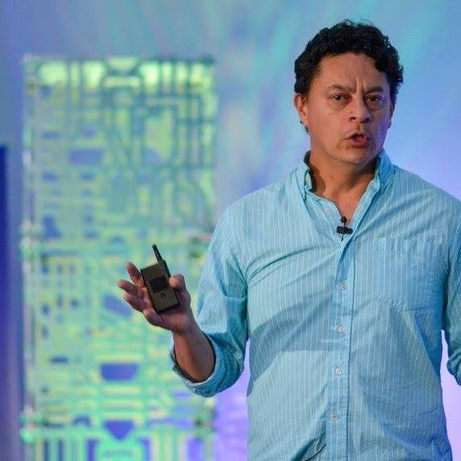
Marketing analytics
Mario A Vinasco
Data Science And Analytics
Uber Technologies

Slide 2
- Brief Intro to AI and ML - ML Platforms at Uber - Models used in Marketing@Uber - Use Cases - Q&A
Topics

Slide 3
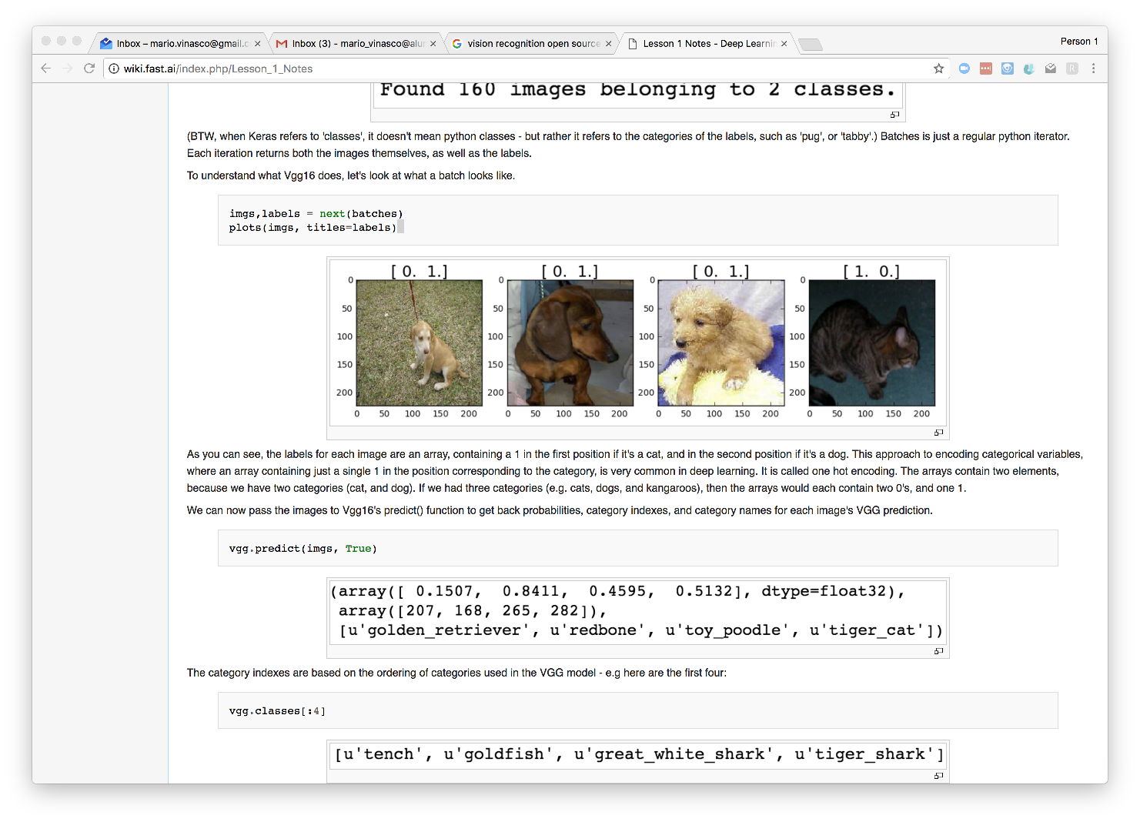
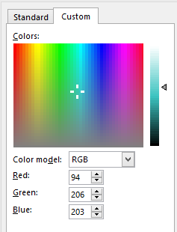
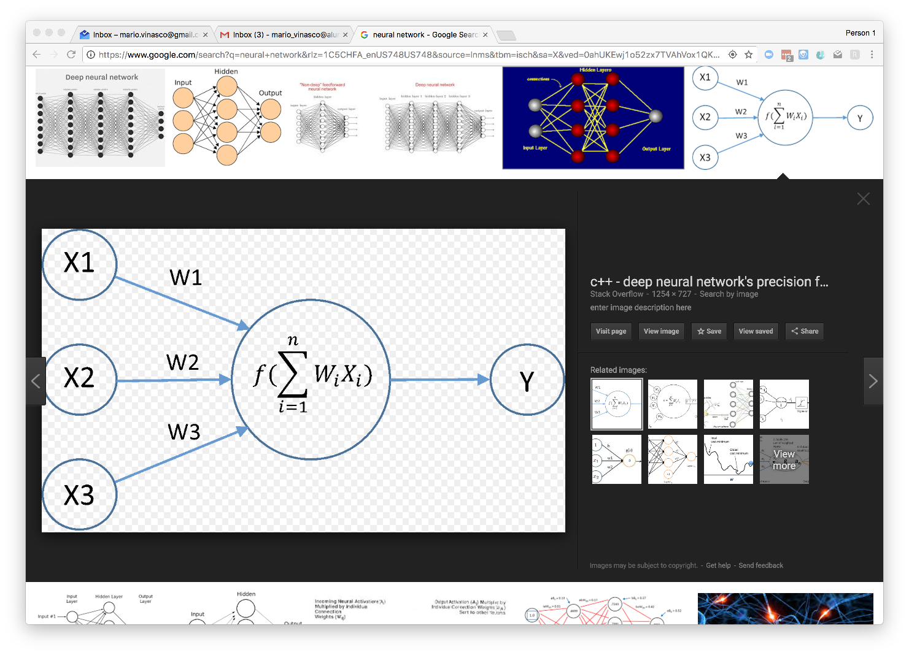
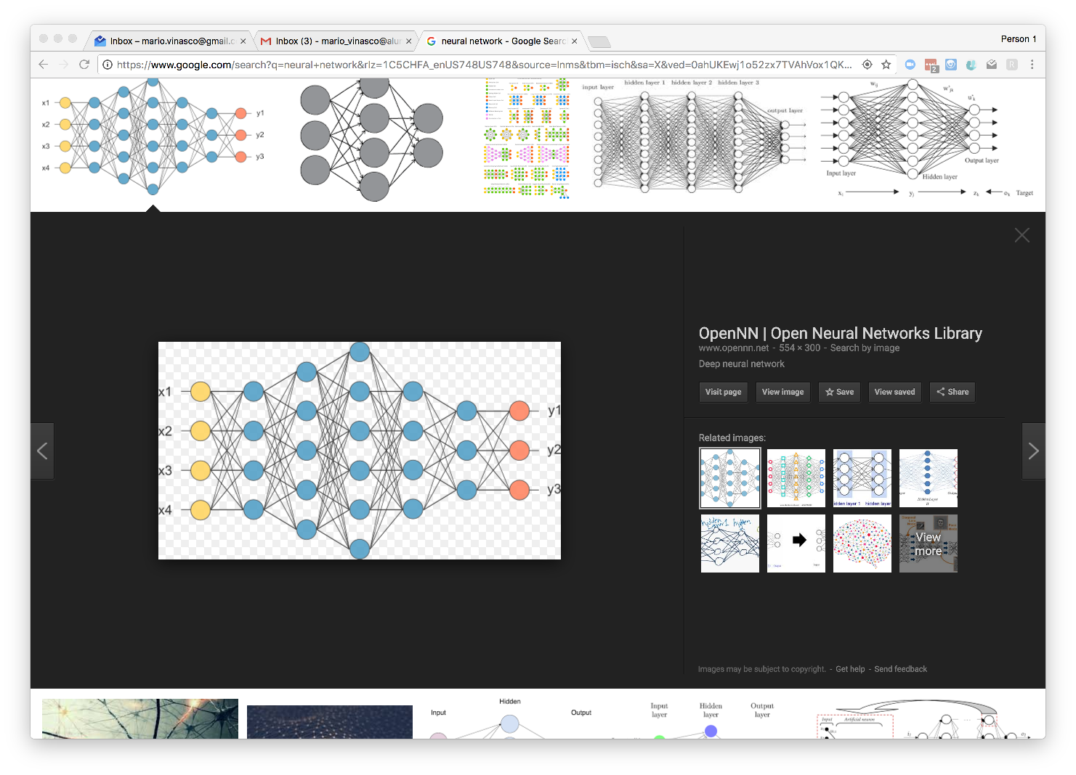
The most popular use of AI is image recognition
Notes:
Hasta hace unos 2 o 3 años, distinguir imagenes de estas era virtualmente imposible para un computador.
- avances en GPU
- adaptacion del metodo ‘gradient descent’
- disponibilidad de grandes volumenes de datos para entrenar las redes

Slide 4


Models at Uber: ‘Churn’
True Positive
100%
80%
Threshold
Metric
Accuracy | how often is the classifier correct? | (TP+TN)/total
Precision | When it predicts yes, how often is it correct? | TP/predicted yes
Recall | When it's actually yes, how often does it predict yes? | TP/actual yes
0%
Notes:
http://www.dataschool.io/simple-guide-to-confusion-matrix-terminology/
Recall: True Positive Rate

Slide 5
Distribution of Users by predicted scores

Slide 6
ML Platforms at Uber
MichelAngelo
Michelangelo enables internal teams to seamlessly build, deploy, and operate machine learning solutions at Uber’s scale.
The system also supports traditional ML models, time series forecasting, and deep learning.
Michelangelo consists of a mix of open source systems and components built in-house. The primary open sourced components used are HDFS, Spark, Samza, Cassandra, MLLib, XGBoost, and TensorFlow.
It follows a six-step workflow:
Manage data
Train models
Evaluate models
Deploy models
Make predictions
Monitor predictions
ML is open source: https://eng.uber.com/michelangelo/

Slide 7
Cases
Communication Frequency
Cross Sell
Q&A

Slide 8
How many emails should we send to our Riders/Drivers?
What is the optimal level so we avoid un-subscription and yet communicate well?
For a long time, we had a ‘One size’ fits all
We capped the number of marketing emails to our Riders, Drivers and Eaters at a fix number per week
Clearly, some segments expected less communications and unsubscribed accordingly, while others appreciated higher numbers.
Its not an easy problem to identify these segments

Slide 9
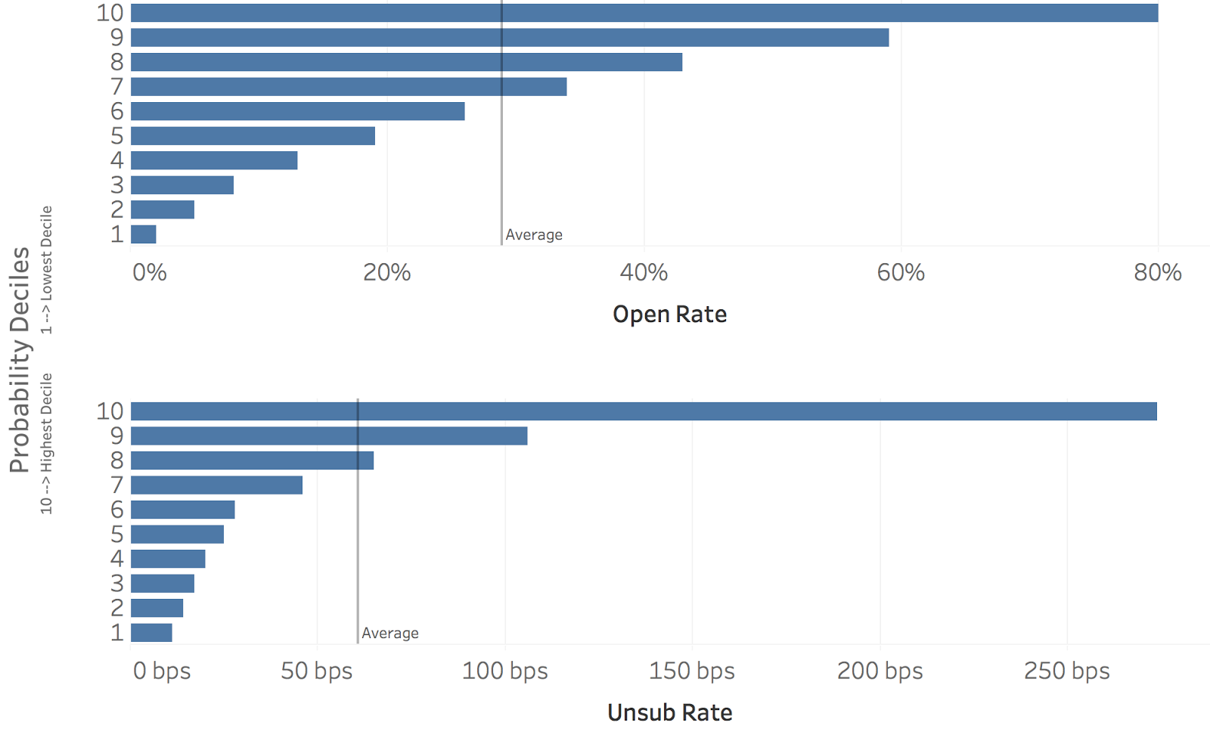
Use several ML models as Segmentation tools
By crossing predictive scores we identify cohorts of high and low risk for comms.

Slide 10
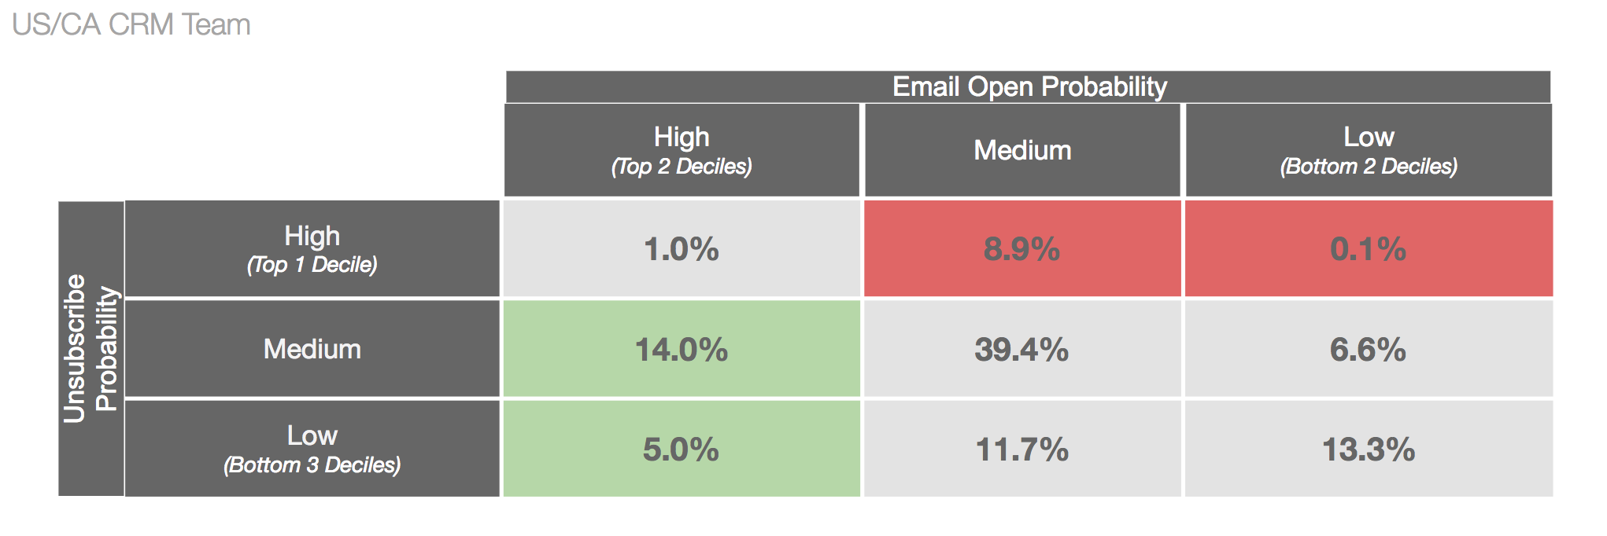
We formulated a new communication strategy
We recommended a reduction for the red cohort and increase for the green one.

Slide 11
Agenda
Communication Frequency
Cross Sell
Q&A

Slide 12


Rider to Eater
R2E is our biggest acquisition advantage comparing to competitors
80% eaters* are riders* but only 10% riders are eater
Model Objective: Identify what kind of Riders are more likely to become an Eater

Slide 13
Model Building
Feature collection and Training
Collect features …..user info and trip history of riders with at least one trip in last 12 weeks | Predict …..probability of making an EATs order in the next 28 days

Slide 14
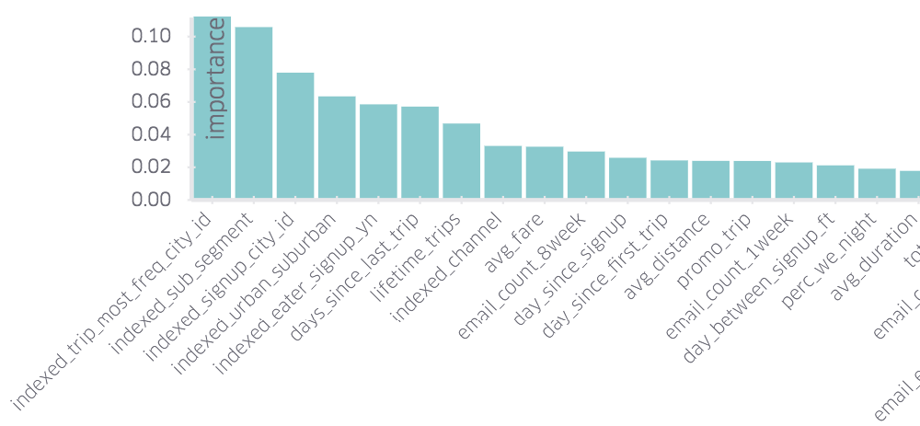
Model Output
Uber uses an internal tool called MichelAngelo
Top 30 features

Slide 15
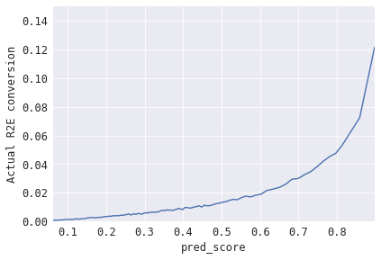
Model Performance
The model identifies a segment with +15X the conversion rate
High Conversion 15X
Avg Conversion

Slide 16
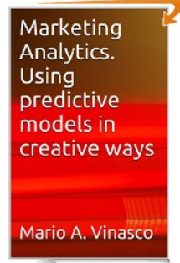
Thank you !
Mario A. Vinasco
Mario_Vinasco@Alumni.Stanford.edu
Marketing Analytics - using predictive models in
creative ways [Kindle Edition]
ASIN:B00CX7HN30 http://www.amazon.com/Marketing-Analytics-predictive-creative-ebook/dp/B00CX7HN30

